Slide 1
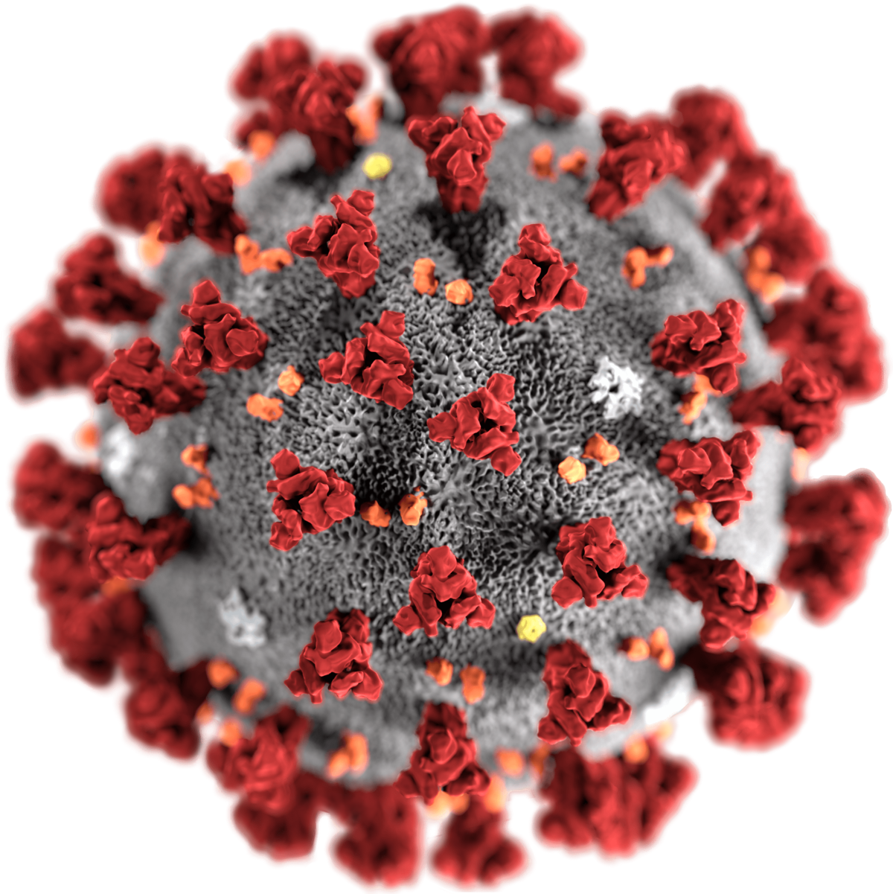
Detecting
Covid-19 From X-Rays
PRESENTED ON 20-05-2021

Slide 2
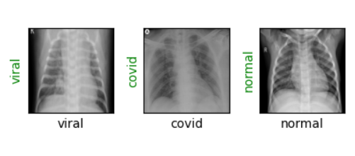
OBJECTIVE
To develop a fully automatic framework to detect COVID-19 using chest x-ray.
To develop a model that uses Deep learning to detect coronavirus disease 2019 (COVID-19) and distinguish it from normal and community acquired pneumonia affected x-rays.

Slide 3
PROBLEM STATEMENT
COVID-19 is posed as very infectious and deadly pneumonia type disease until recent time.
Novel coronavirus or SARS-COV-2 strain is responsible for COVID-19 and it has already shown the deadly nature of respiratory disease by threatening the health of millions of lives across the globe.
Clinical study reveals that a COVID-19 infected person may experience dry cough, muscle pain, headache, fever, sore throat and mild to moderate respiratory illness.
At the same time, it affects the lungs badly with virus infection. So, the lung can be a prominent internal organ to diagnose the gravity of COVID-19 infection using X-Ray and CT scan images of chest.
Despite having lengthy testing time, RT-PCR is a proven testing methodology to detect coronavirus infection.
Sometimes, it might give more false positive and false negative results than the desired rates.

Slide 4
SOLUTION
To assist the traditional RT-PCR methodology for accurate clinical diagnosis, COVID-19 screening can be adopted with X-Ray and CT scan images of lung of an individual.
This image based diagnosis will bring radical change in detecting coronavirus infection in human body with ease and having zero or near to zero false positives and false negatives rates.
Machine learning provides useful analysis to study a large amount of chest x-ray images that can critically impact on screening of Covid-19.

Slide 5
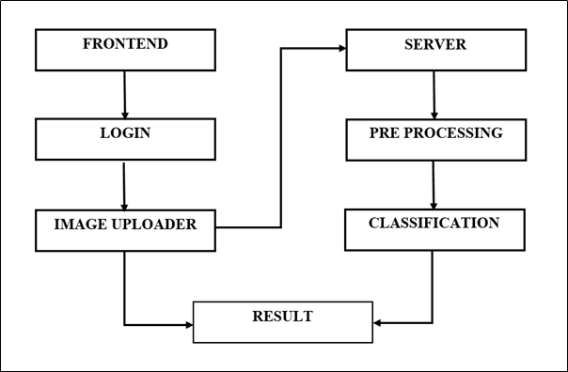
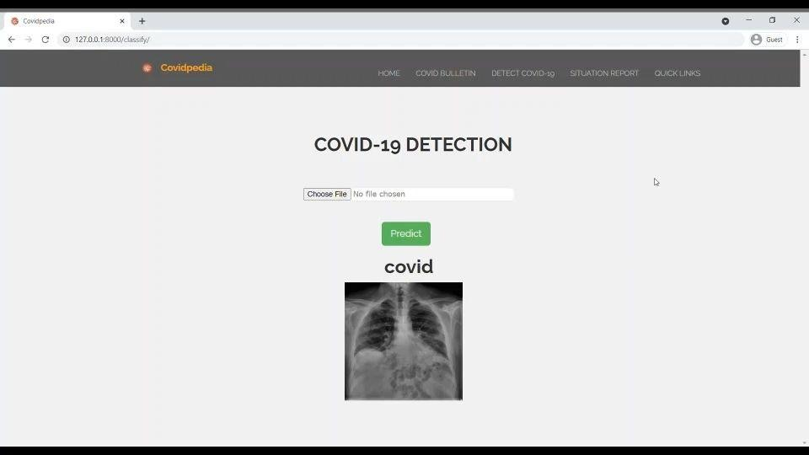
BLOCK DIAGRAM

Slide 6
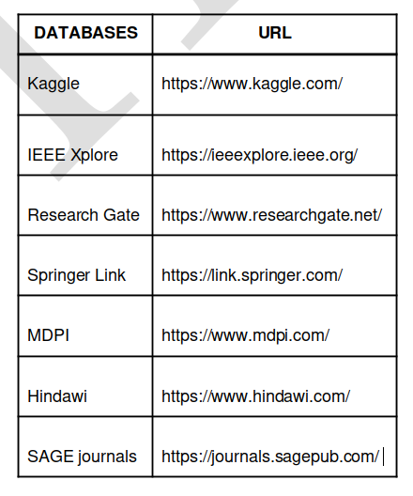
DATASET
Data augmentation techniques like rescaling, zooming, height and width shifting and flipping were performed on the input images
Total of 8252 images were divided into training and testing dataset
Training and testing dataset were categorized into normal, viral pneumonia and covid-19.

Slide 7
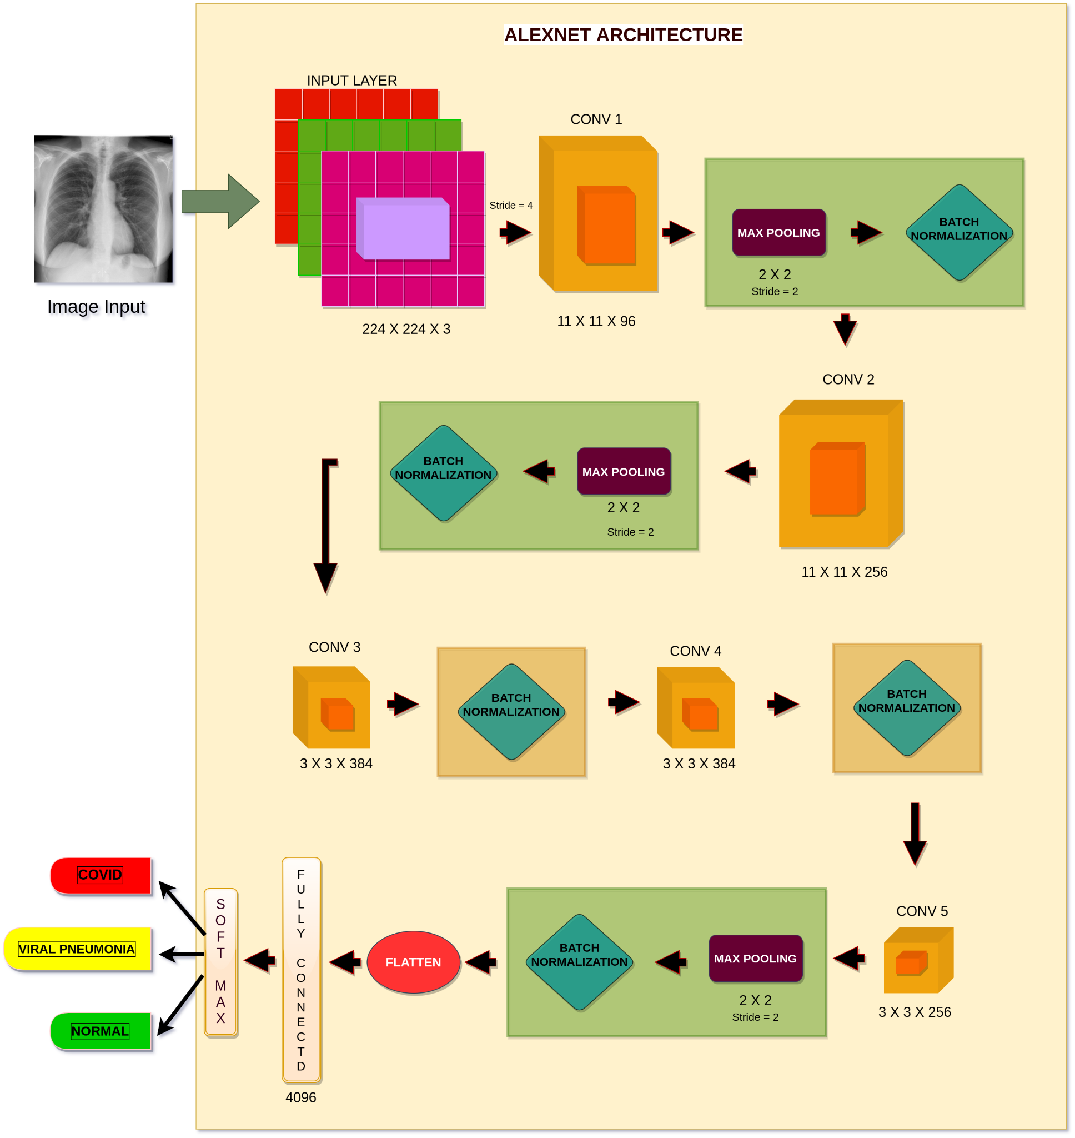
ALEXNET ARCHITECTURE

Slide 8
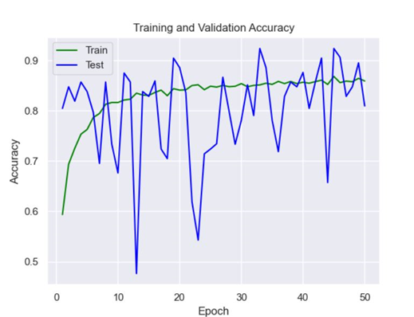
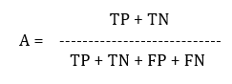
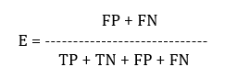
TRAINING AND TESTING ACCURACIES
Epochs = 50
Time taken for training = 693 seconds/epoch
Training accuracy = 83 %
Validation accuracy = 80%

Slide 9
TECHNICAL STACK
OPERATING SYSTEM | Windows 10
SOFTWARE PACKAGE | Pycharm Professional
LANGUAGE | Python
BACKEND FRAMEWORK | Django
FRONTEND | Django Templates
LIBRARIES | Torch vision, Torch, Matplotlib, Numpy, Python Image Library (PIL)

Slide 10
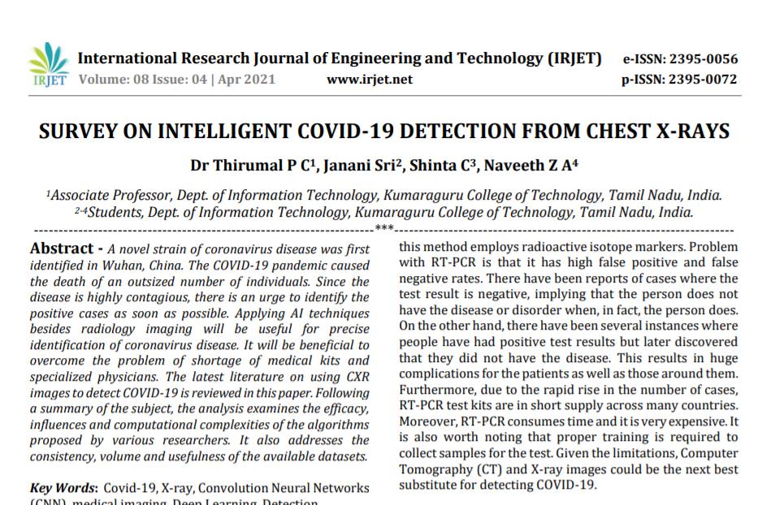
SURVEY PAPER
https://www.irjet.net/archives/V8/i4/IRJET-V8I4998.pdf

Slide 11
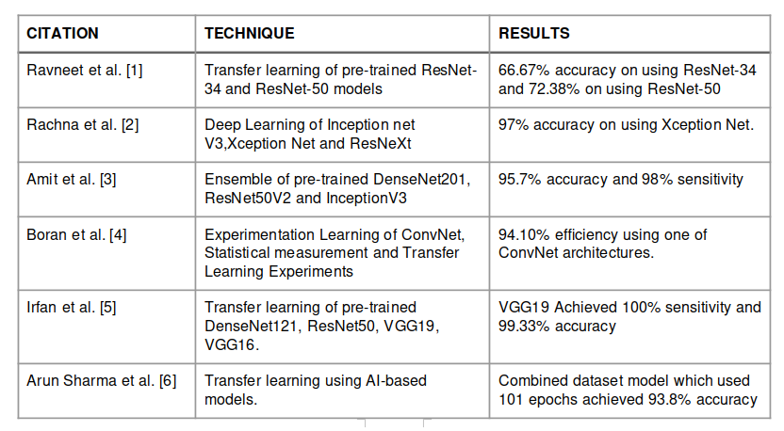
WORKS COMPARED IN SURVEY PAPER

Slide 12
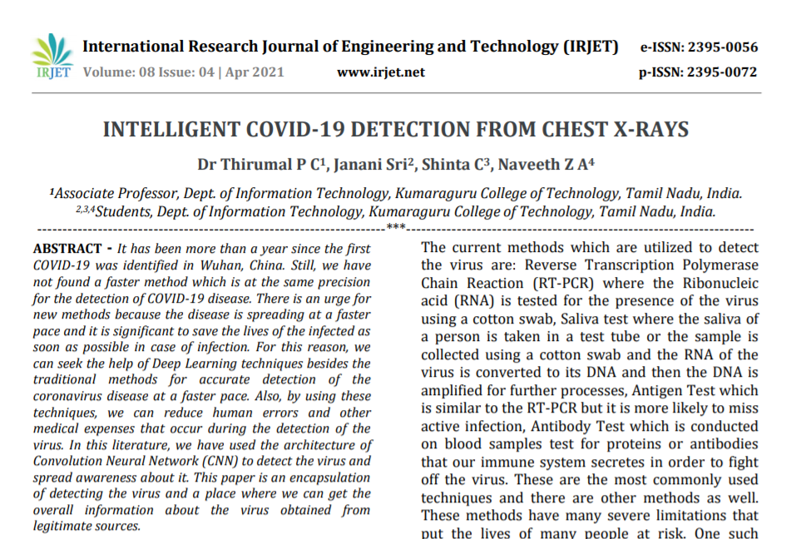
MAIN PAPER
https://www.irjet.net/archives/V8/i4/IRJET-V8I4999.pdf

Slide 13
WEB APPLICATION - Demo ...

Slide 14
THANK YOU
PRESENTED BY:
Naveeth Z A - 17BIT031
Shinta C - 17BIT033
Janani Sri - 17BIT056
GUIDED BY:
Dr. Thirumal P C

